Slide 1
Water pH Monitoring
Project Done By :
Fiza Husain, Medha Vempati and Harika Katta

Slide 2
What is the aim of project?
The aim of this project is to monitor pH of water using micro controller ESP-32. We will use pH probe to measure the pH. We'll need to combine the sensor system with the micro controller.

Slide 3
Components Required
pH electrode(BNC connector)
pH Sensor Circuit Board
Analog Cable
ESP32 micro controller
ADC Converter(?)

Slide 4
pH Sensor
Module Power : 5.00V
Module Size : 43mmx32mm（1.70"x1.26")
Measuring Range : 0-14 pH
Measuring Temperature : 0-60 ℃
Accuracy : ± 0.1pH (25 ℃)
Response Time : ≤ 1min
Industry pH Electrode with BNC Connector
PH2.0 Interface ( 3 foot patch )
Gain Adjustment Potentiometer
Power Indicator LED

Slide 5
pH Sensor
This sensor is used for industrial purposes , so it can be immersed in water for long periods (more than 1 year) without worrying about damage.
The pH electrode is made of sensitive glass membrane. It responds fast and is thermally very stable.
The electrode membrane doesn’t get clogged easily, so it is suitable for long term detection

Slide 6
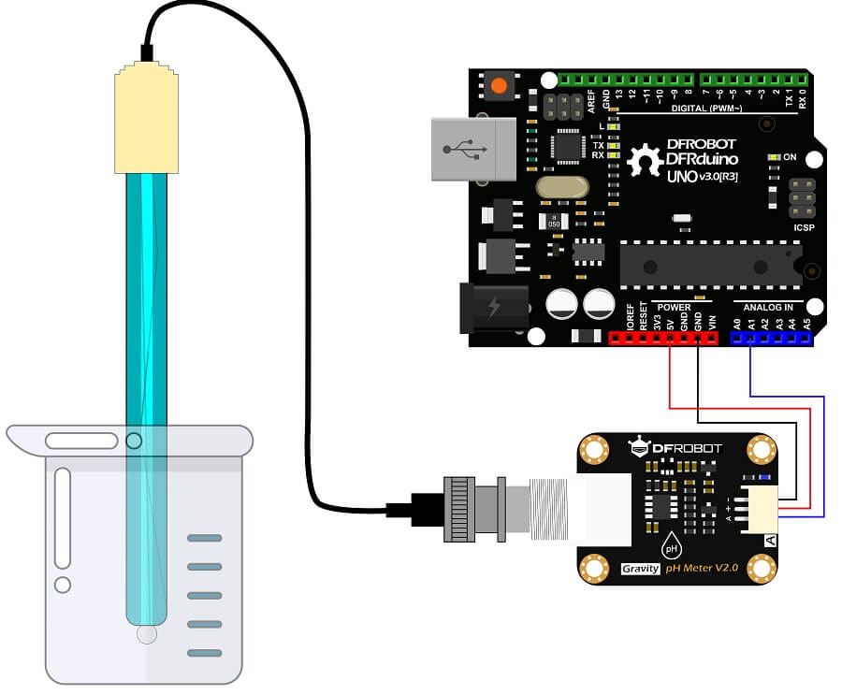

Slide 7
Challenges
The challenges we are most likely going to face :
1. Power : How to get access to a continuous power source that doesn’t falter on the roof of a building
2. Connectivity : How to set up a wired or wireless connection in proximity of the IoT device
3. Location : Where to deploy the device

Slide 8
Solutions
Potential solutions to the earlier mentioned concerns
1. Location : Bakul rooftop water tanker
2. Power : There is a water purifier system set up on Bakul’s roof. The same power source can be used for our IoT device
3. Connectivity : A common router can be set up on the top floor of Bakul to ensure Wifi connection

Slide 9
Software
1. Arduino : We are using the Arduino IDE to interact with ESP32 micro-controller
2. We are using the ThingSpeak platform for cloud storage. The data collected from the pH sensor is processed by the micro controller, then sent to be stored in the cloud.

Slide 10
ThingSpeak
1. We need to make a ThingSpeak account and a subsequent channel on our account.
2. A library relevant to ThingSpeak needs to be downloaded and installed in the Arduino IDE
3. We note the API key and the channel ID to connect the specific channel to the devices and the Arduino code.
4. We need to make use of commands like ThingSpeak.writeFields() to send data to the cloud

